Slide 1

Blockchain Technology
Khed Taluka Shikshan Prasarak Mandal’s
Hutatma Rajguru Mahavidyalaya, Rajgurunagar, Pune- 410505
TYBBA(CA)
A Presentation On
And Secure Transactions
Presented by: Abhishek Arun Gade
BBA (Computer Applications)
Roll No: 22
Guide : Prof. R. S Jadhav Madam

Slide 2
Introduction to Blockchain
Blockchain is a digital ledger that records transactions securely and transparently.
It is decentralized, meaning no single authority (like a bank) controls it.
Transactions are stored in blocks and linked together in a chain, forming a secure and tamper-proof system.

Slide 3
Why Blockchain?
Traditional systems rely on third parties (banks, payment gateways, etc.), which can be slow and costly.
Blockchain removes middlemen, making transactions faster and cheaper.
Security – Data in the blockchain is encrypted and cannot be altered.
Transparency – All transactions are visible to network participants, reducing fraud.
Efficiency – Smart contracts can automate processes, reducing paperwork.

Slide 4
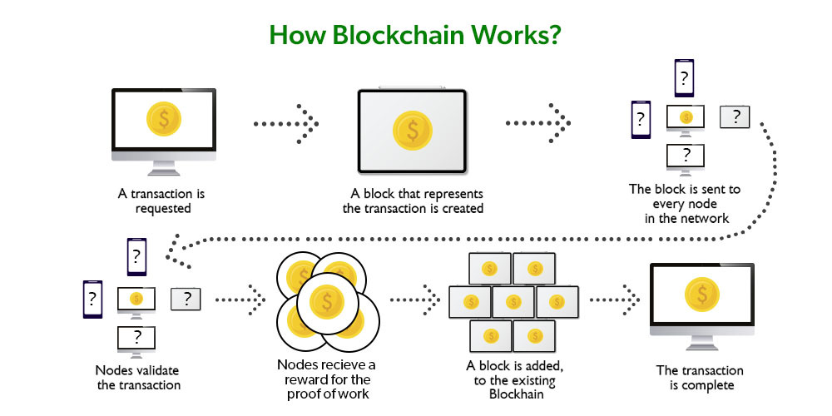

Slide 5
How Does Blockchain Work?
Transaction Initiation – A user requests a transaction (e.g., sending money).
Broadcast to Network – The transaction is shared with multiple computers (nodes).
Verification – The network verifies the transaction using a consensus method (Proof of Work/Proof of Stake).
Transaction Added to a Block – Once approved, the transaction is stored in a block.
Block is Linked to Blockchain – The new block is connected to the previous block, forming a chain.
Updated Blockchain is Shared – The new version is distributed across the network, ensuring security and consistency.

Slide 6
Types of Blockchain
Public Blockchain – Open to everyone (e.g., Bitcoin, Ethereum).
Private Blockchain – Restricted access, used by businesses (e.g., banking systems).
Hybrid Blockchain – A mix of public and private features, offering controlled transparency.

Slide 7
Applications of Blockchain
Cryptocurrency – Used for digital currencies like Bitcoin, Ethereum.
Supply Chain Management – Tracks the movement of goods, ensuring authenticity.
Cybersecurity – Protects personal and financial data from hacking.
Healthcare – Stores patient records securely and ensures data privacy.

Slide 8
Advantages and Challenges
✅ ADVANTAGES:
High security – Data cannot be altered once stored.
No middlemen – Reduces transaction costs.
Faster transactions – Works 24/7 without delays.
❌ CHALLENGES:
Energy consumption – Mining requires a lot of electricity.
Scalability issues – Handling large transactions is still a challenge..
Regulatory uncertainty – Many governments are still deciding how to regulate blockchain.

Slide 9
Conclusion
Blockchain is transforming industries by offering security, transparency, and efficiency.
It has challenges, but its potential is huge for the future.
Businesses and governments are actively exploring blockchain for real-world use cases.

Slide 10
THANK YOU
Any questions?

